Slide 1
Optimize decision-making efficiency and speed by performing exploratory analysis through the MedDRAH platform
Zhiping Yan, Dizal (Jiangsu) Pharmaceutical Co., Ltd.

Slide 2
Our Needs
临床试验期间的安全性评价的主要目的是通过对安全性数据的持续监测、分析，评估药物安全性特征，及时识别出可疑且非预期严重不良反应等重大的风险，并采取适当措施充分控制风险，保护受试者的安全。
–《新药临床安全性评价技术指导原则 2023年12月》
The important thing is to have a thoughtful process; a system in place to look for clinically important imbalances, applying the best clinical and quantitative judgment, while maintaining trial integrity – Jacqueline Corrigan-Curay (Principal Deputy Center Director in the FDA’s Center for Drug Evaluation and Research)

Slide 3
Today’s Challenges
How to effectively implement real-time monitoring and visualization of clinical data for the purpose of enhancing medical scientific review and ensuring data quality
How to break down the barrier of difficulty in sharing clinical data across different functions and various contents
How to conduct the Ongoing Aggregate Safety Evaluations (OASEs) to enhance the efficiency and speed of decision making during the trial

Slide 4
What’s the MedDRAH
Medical Data Review and Analysis Hub (MedDRAH /’med’ra:/) is an interactive Web-based real-time clinical trial data monitoring and analysis platform that enables Medical and PV Physicians, Statisticians, and PK Scientists to review, analyze, and generate reports through intuitive point-and-click wizards.
Review real-time EDC and SDTM data
Generate visual reports for medical data scientific review
Perform comprehensive exploratory analysis utilizing a complete suite of analysis and reporting (A & R) tools
Create the patient narratives
Conduct standardized pharmacokinetic statistical analyses, including assessments of dose-proportionality, food/fed effects, drug-drug interactions (DDI), and exposure-response (E-R) relationships
……

Slide 5
The Concept of Technology Platform

Slide 6
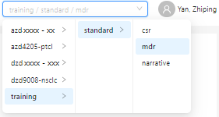
Folder Structure
Level1 | Level2 | Level3 | Level4 | Level5 | Level6 | Level7 | Level8 | Level9 | Expected Content
dizalmdh
 | ar-mdr | mdr-mdr |  |  |  |  |  |  | The global related metadata
 |  | mdr-narrative |  |  |  |  |  |  | The global related metadata like narrative template
 |  | mdr-csr |  |  |  |  |  |  | The global related metadata
 | ar-dev
 |  | training |  |  |  |  |  |  | Compound/indication level programming
 |  |  | standard |  |  |  |  |  | Study level programming
 |  |  |  | crts
 |  |  |  |  | mdr
 |  |  |  |  |  | edc |  |  | EDC data
 |  |  |  |  |  | sdtm |  |  | SDTM datasets
 |  |  |  |  |  | adam |  |  | Derived MDR datasets
 |  |  |  |  | narrative
 |  |  |  |  |  | edc |  |  | EDC data
 |  |  |  |  |  | sdtm |  |  | SDTM datasets
 |  |  |  |  | csr
 |  |  |  |  |  | edc |  |  | EDC data
 |  |  |  |  |  | sdtm |  |  | SDTM datasets
 |  |  |  |  |  | adam |  |  | ADaM datasets
 |  |  |  | pgmanal
 |  |  |  |  | mdr
 |  |  |  |  |  | adam |  |  | ADaM data
 |  |  |  |  |  | reports |  |  | R Program
 |  |  |  |  | csr
 |  |  |  |  |  | adam |  |  | ADaM data
 |  |  |  |  |  | reports |  |  | R Program
 |  |  |  | reports
 |  |  |  |  | mdr
 |  |  |  |  |  | graphs |  |  | Downloaded graphs from MDH webpage
 |  |  |  |  |  | tables |  |  | Downloaded tables from MDH webpage
 |  |  |  |  | narrative
 |  |  |  |  |  | data |  |  | Derived Narrative datasets
 |  |  |  |  |  | templates |  |  | Narrative Template
 |  |  |  |  |  | narratives |  |  | Narratives outputs
 |  |  |  |  | csr
 |  |  |  |  |  | graphs |  |  | Downloaded graphs from MDH webpage
 |  |  |  |  |  | listings |  |  | Downloaded listings from MDH webpage
 |  |  |  |  |  | tables |  |  | Downloaded tables from MDH webpage
Folder Name in blue will be used for Access Control

Slide 7
Access Control for Web Page
API provided by IT to get access group names for each user
{name: “Yan, Zhiping",
email: "Zhiping.Yan@dizalpharma.com",
groups: ["DZ-MDH-STANDARD", "DZ-MDH-DZXXXXXXX1", "DZ-MDH-DZXXXXXXX2", "DZ-MDH-DZXXXXXXX3",…]
}
Unique information for each user
MedDRAH API to get folder names based on group names
http://xxxxxx.dizalxxx.xxx/xxx/xxxx/getdirs/?groups= DZ-MDH-STANDARD, DZ-MDH-DZXXXXXXX1, DZ-MDH-DZXXXXXXX2, DZ-MDH-DZXXXXXXX3
[{value: "training", label: "training", children: [{value: "standard", label: "standard",…}]}
…
…
]
display folder names in web page
Unique group name for each compound/study level folder

Slide 8
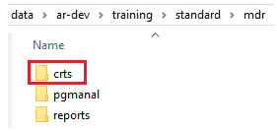
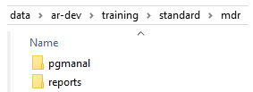
Access Control for Remote Folder
Level1 | Level2 | Level3 | Level4 | Level5 | Level6 | Level7 | Level8 | Level9 | Expected Content
dizalmdh
 | ar-mdr | mdr-mdr |  |  |  |  |  |  | The global related metadata
 |  | mdr-narrative |  |  |  |  |  |  | The global related metadata like narrative template
 |  | mdr-csr |  |  |  |  |  |  | The global related metadata
 | ar-dev
 |  | training |  |  |  |  |  |  | Compound/indication level programming
 |  |  | standard |  |  |  |  |  | Study level programming
 |  |  |  | crts
 |  |  |  |  | mdr
 |  |  |  |  |  | edc |  |  | EDC data
 |  |  |  |  |  | sdtm |  |  | SDTM datasets
 |  |  |  |  |  | adam |  |  | Derived MDR datasets
 |  |  |  |  | narrative
 |  |  |  |  |  | edc |  |  | EDC data
 |  |  |  |  |  | sdtm |  |  | SDTM datasets
 |  |  |  |  | csr
 |  |  |  |  |  | edc |  |  | EDC data
 |  |  |  |  |  | sdtm |  |  | SDTM datasets
 |  |  |  |  |  | adam |  |  | ADaM datasets
 |  |  |  | pgmanal
 |  |  |  |  | mdr
 |  |  |  |  |  | adam |  |  | ADaM data
 |  |  |  |  |  | reports |  |  | R Program
 |  |  |  |  | csr
 |  |  |  |  |  | adam |  |  | ADaM data
 |  |  |  |  |  | reports |  |  | R Program
 |  |  |  | reports
 |  |  |  |  | mdr
 |  |  |  |  |  | graphs |  |  | Downloaded graphs from MDH webpage
 |  |  |  |  |  | tables |  |  | Downloaded tables from MDH webpage
 |  |  |  |  | narrative
 |  |  |  |  |  | data |  |  | Derived Narrative datasets
 |  |  |  |  |  | templates |  |  | Narrative Template
 |  |  |  |  |  | narratives |  |  | Narratives outputs
 |  |  |  |  | csr
 |  |  |  |  |  | graphs |  |  | Downloaded graphs from MDH webpage
 |  |  |  |  |  | listings |  |  | Downloaded listings from MDH webpage
 |  |  |  |  |  | tables |  |  | Downloaded tables from MDH webpage
Only study level Statistical Programmer has access to crts folder
Study level users like Medical, PV Physician, Statistician and Statistical Programmer have access to pgmanal and reports folders

Slide 9
Overview of Front-end & Back-end Technologies
antd: for UI development
react-table: for table development
plotly: for plot development
echarts: for plot development
Front End by React
API generator: Plumber
R package: haven, dplyr, tidyr, stringr, rjson, labelled, ggplot2, survival, survminer
API generator: Flask
Python package: pandas, docx, pyreadstat, re, os, math, matplotlib, numpy
Back End by R
Back End by Python

Slide 10
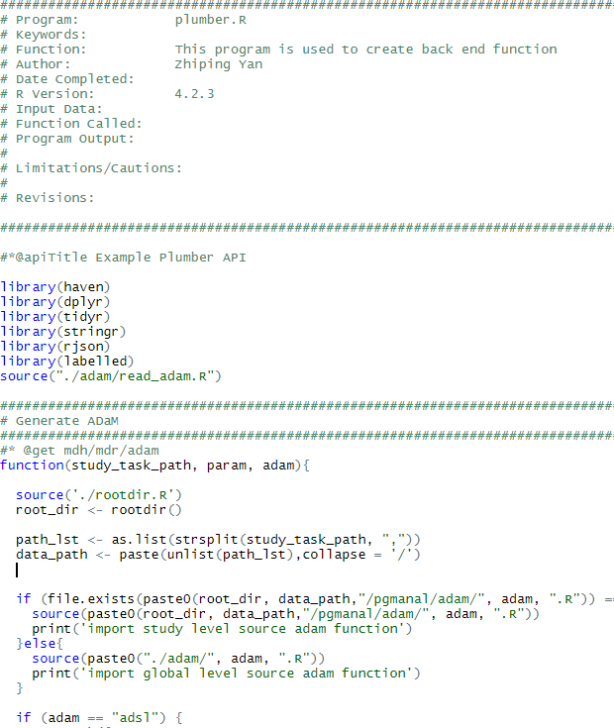
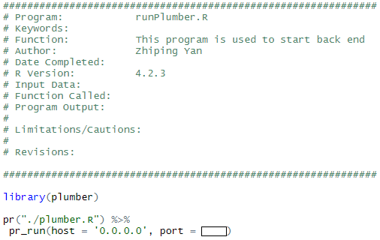
Back End by R via Plumber
Plumber
Allows you to create a web API by merely decorating your existing R source code with roxygen2-like comments.
https://www.rplumber.io/

Slide 11
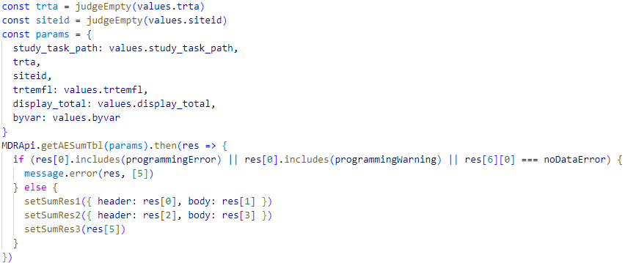
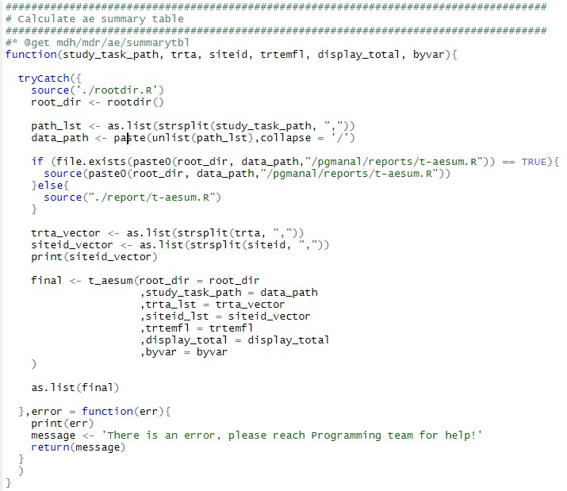
Pass Parameter between React and R
R function to create AE overview summary table
React
R

Slide 12
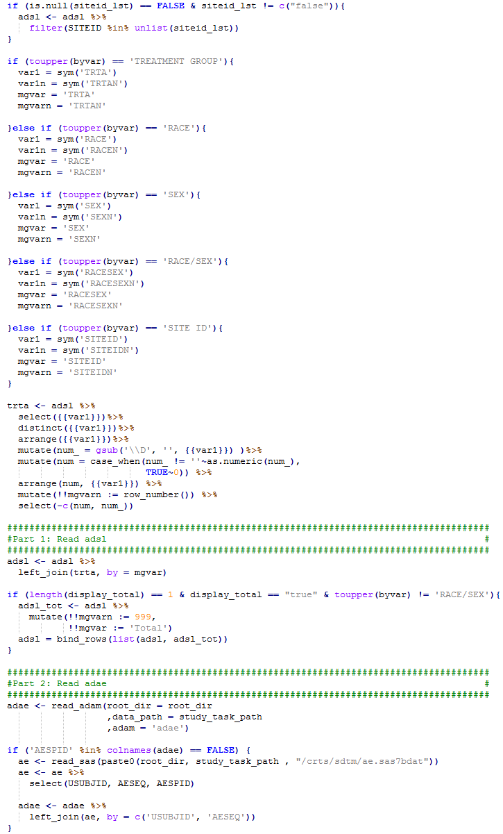
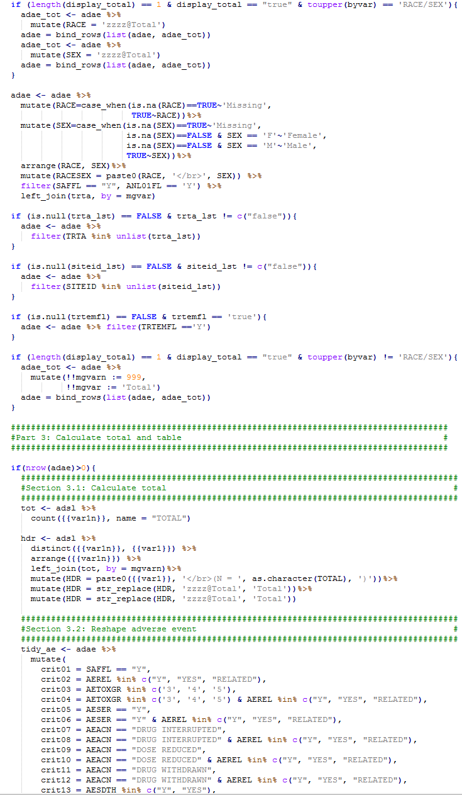

Slide 13
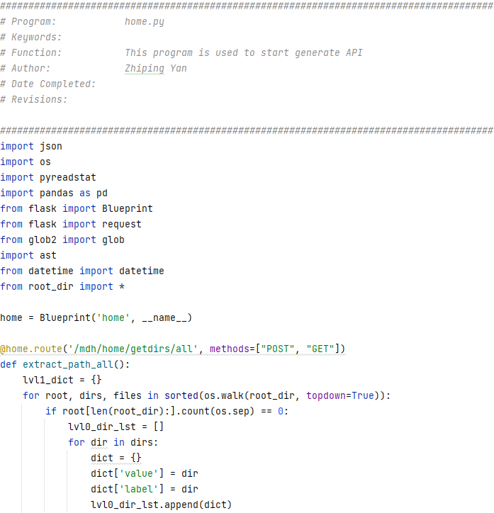
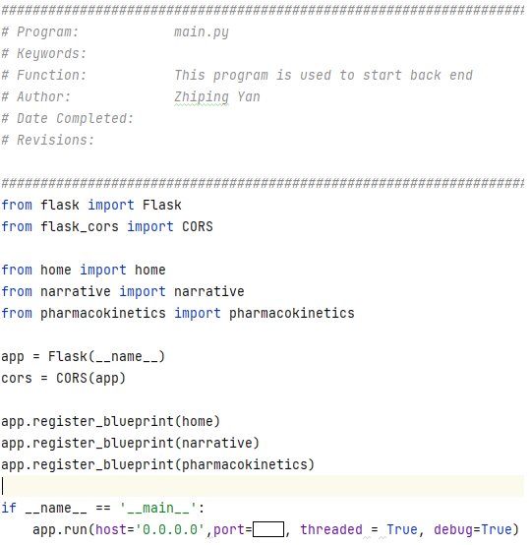
Back End by Python via Flask
Flask
a lightweight WSGI web application framework. It is designed to make getting started quick and easy, with the ability to scale up to complex applications.
https://flask.palletsprojects.com/en/3.0.x/

Slide 14
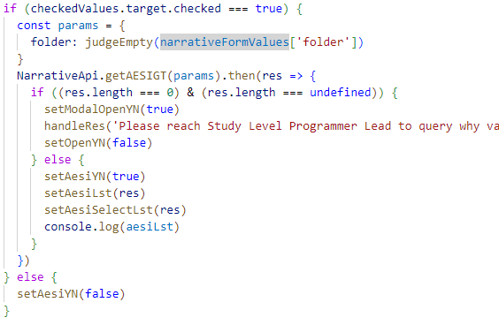
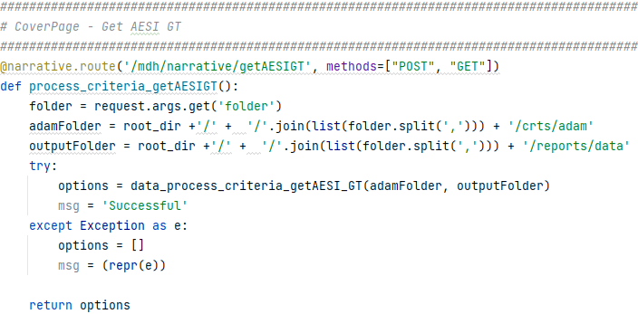
Pass Parameter between React and Python
Python
React

Slide 15
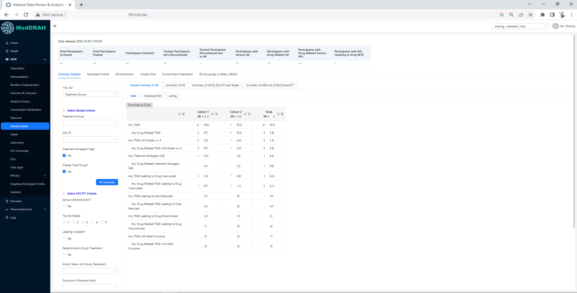
Front End by React - Component
antd
provides plenty of UI components to enrich your web applications, and we will improve components experience consistently
https://ant.design/components/overview/
react-table
supercharge your tables from scratch while retaining 100% control over markup and styles
https://tanstack.com/table/latest

Slide 16
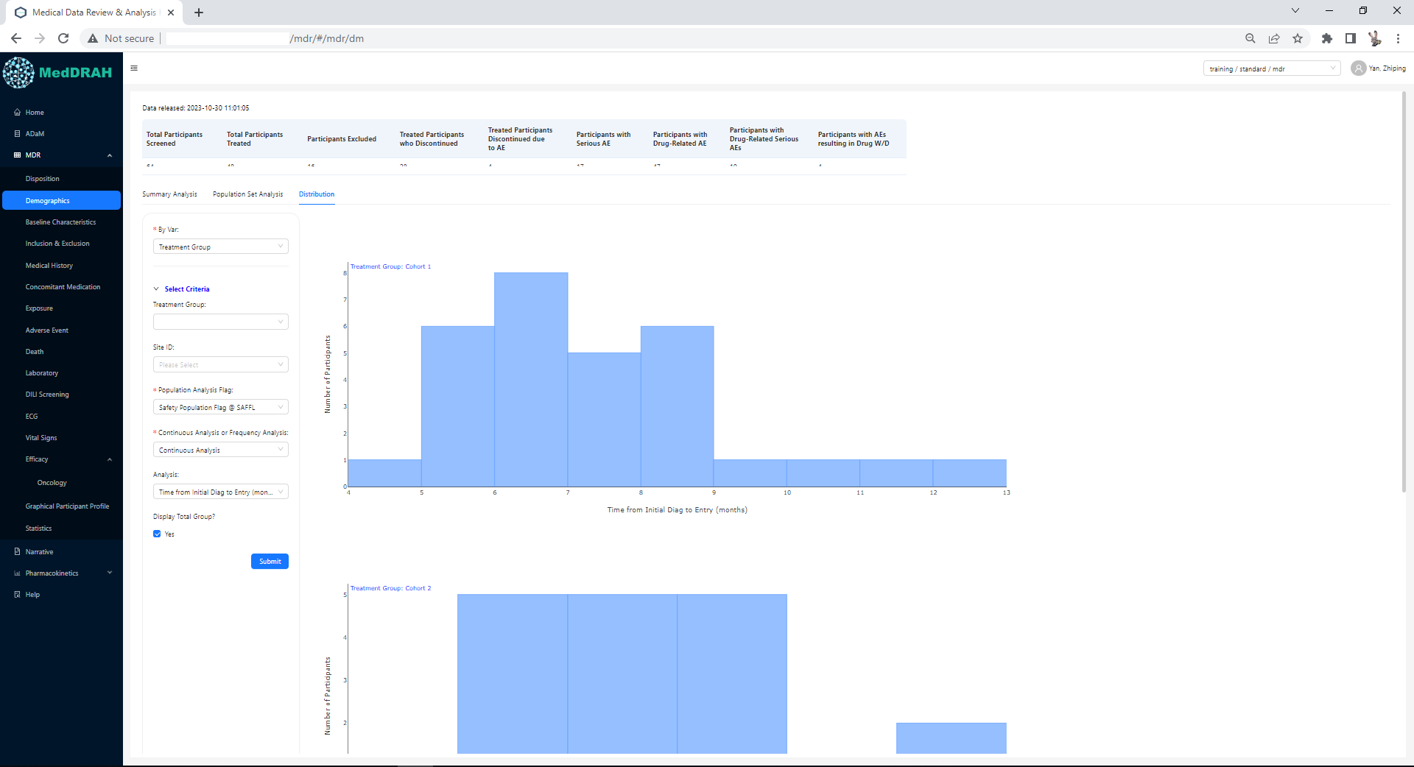
Front End by React - Component
plotly
a high-level, declarative charting library. plotly.js ships with over 40 chart types, including 3D charts, statistical graphs, and SVG maps
https://plotly.com/javascript/

Slide 17
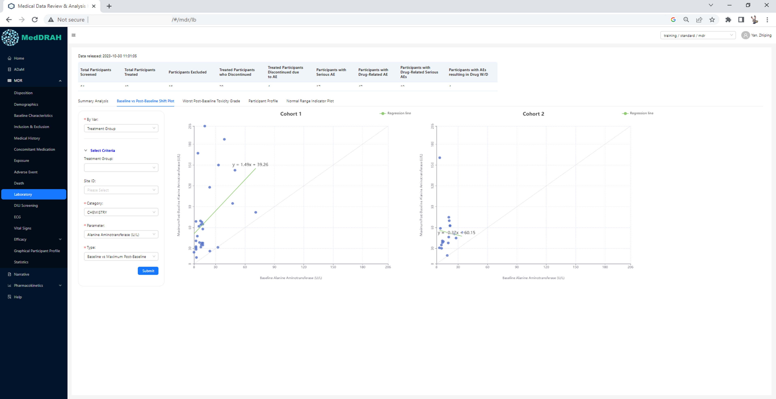
Front End by React - Component
echarts
another open source JavaScript visualization library
https://echarts.apache.org/en/index.html

Slide 18
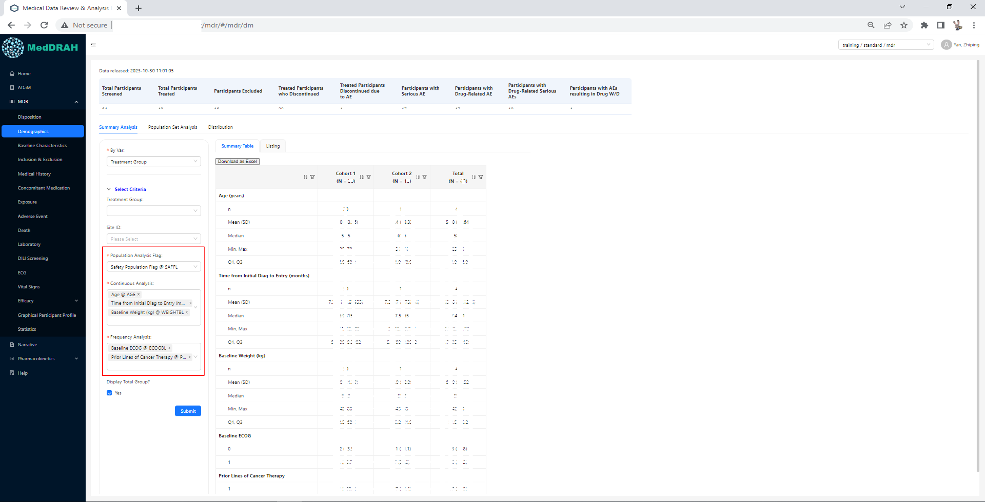
Front End by React – Example
Recommended approach to perform continuous analysis and frequency analysis

Slide 19
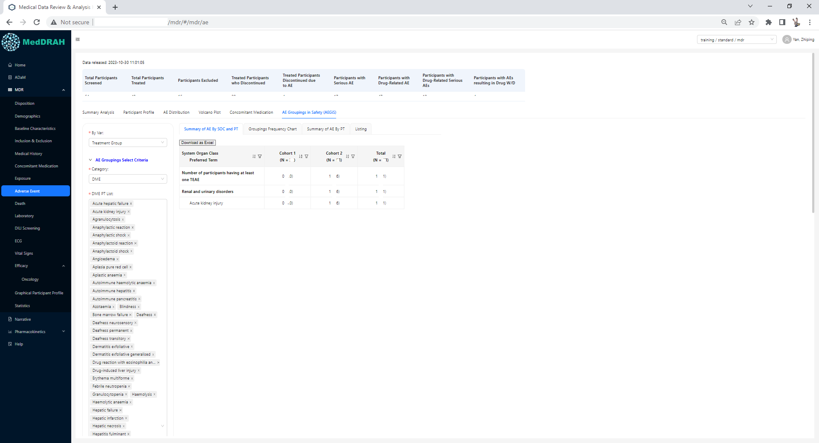
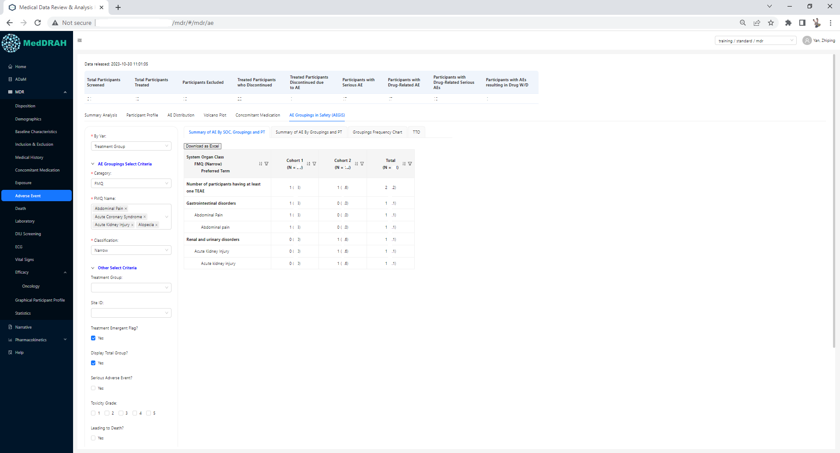
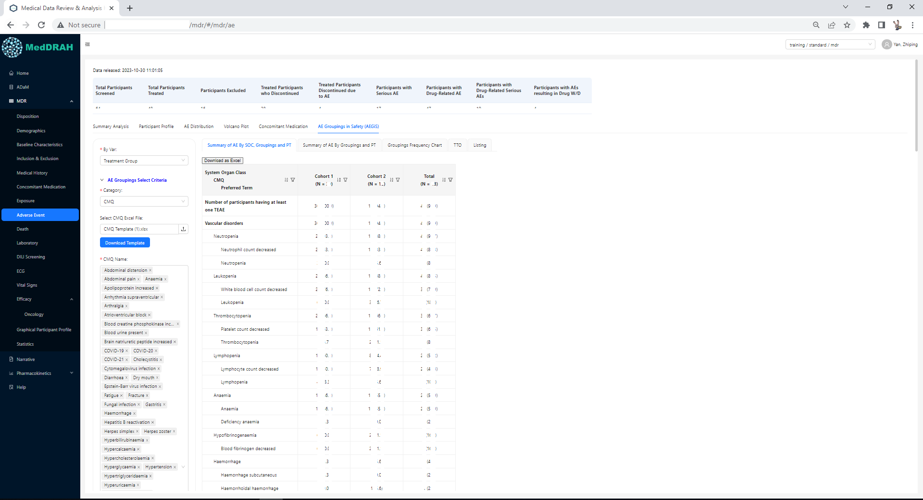
Front End by React – Example
AEGiS analysis for PV Physician

Slide 20
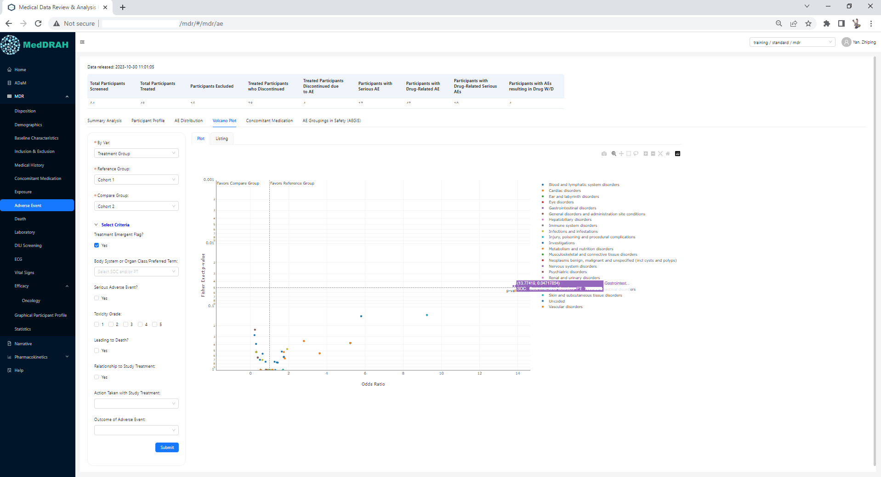
Front End by React – Example
Volcano plot

Slide 21
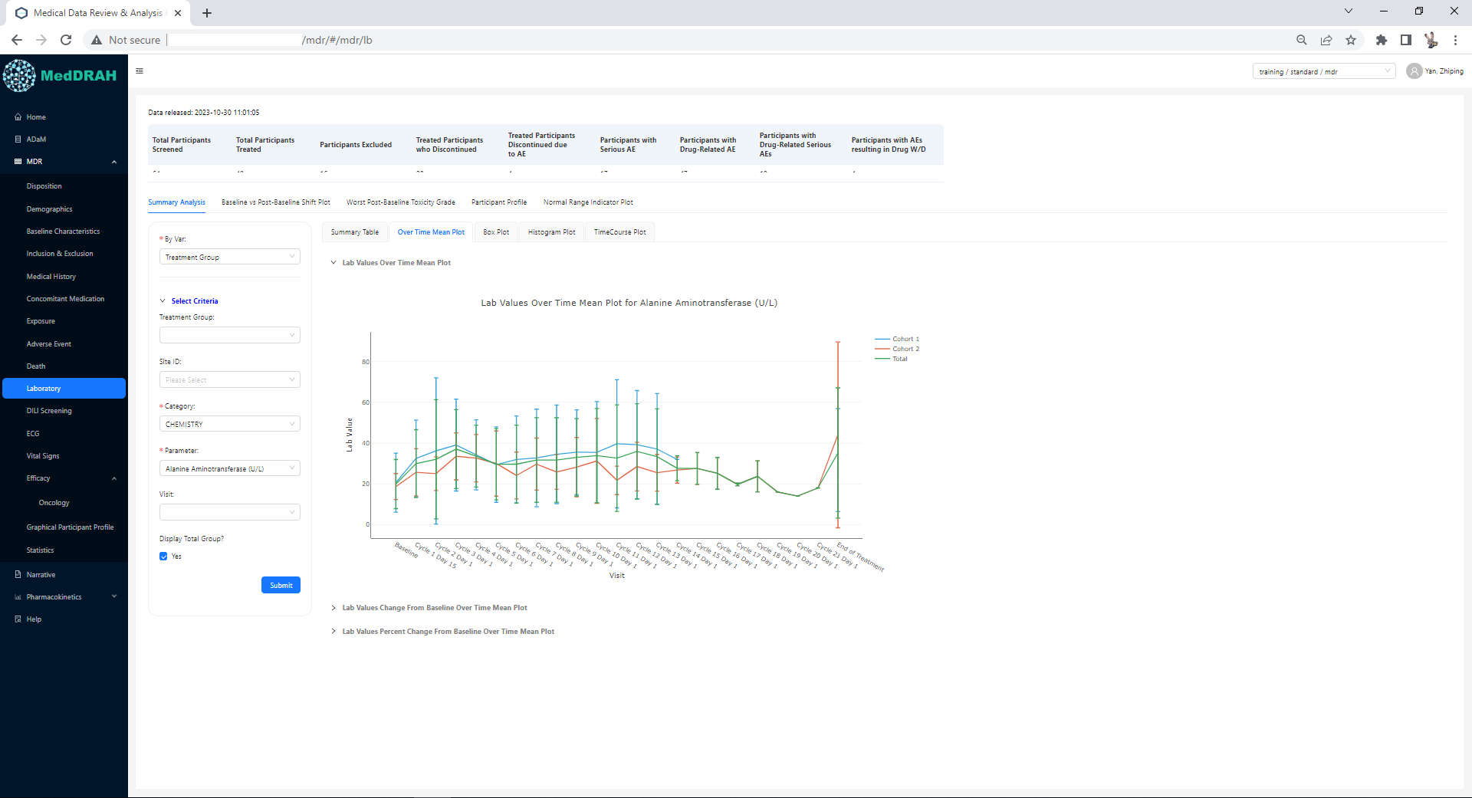
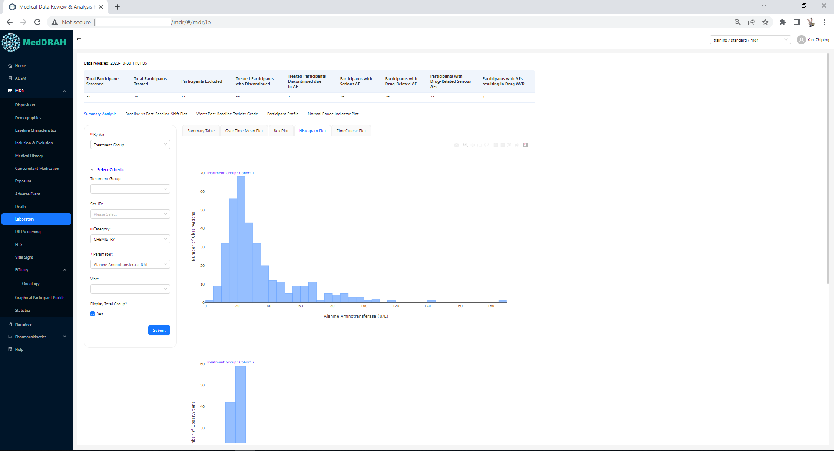
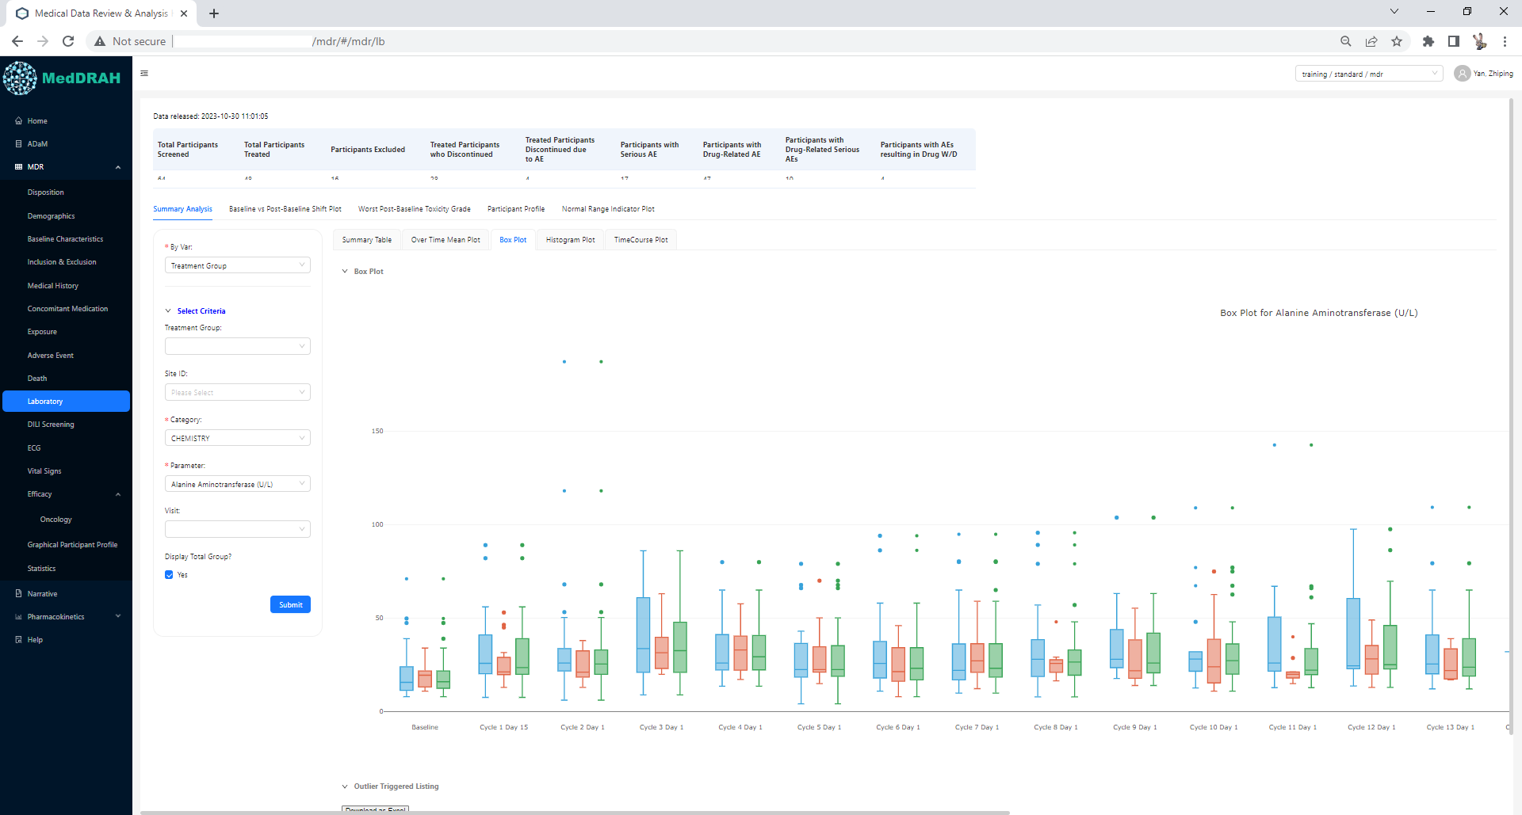
Front End by React – Example
Example plot to view the distribution of continuous data

Slide 22
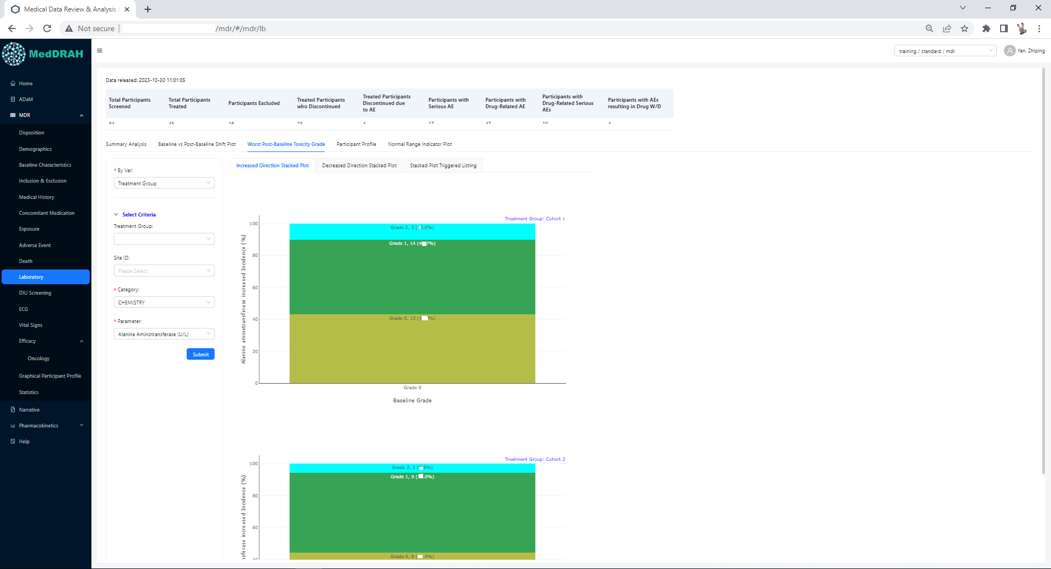
Front End by React – Example
Example plot to view worst post-baseline toxicity grade

Slide 23
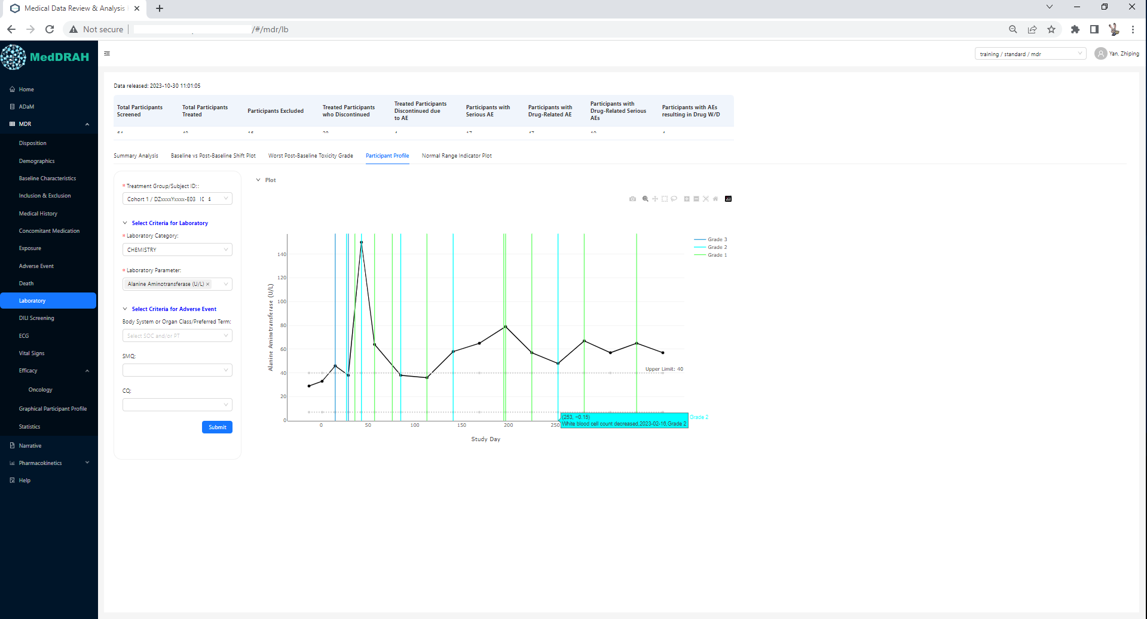
Front End by React – Example
Example plot to view longitudinal data and adverse event data together

Slide 24
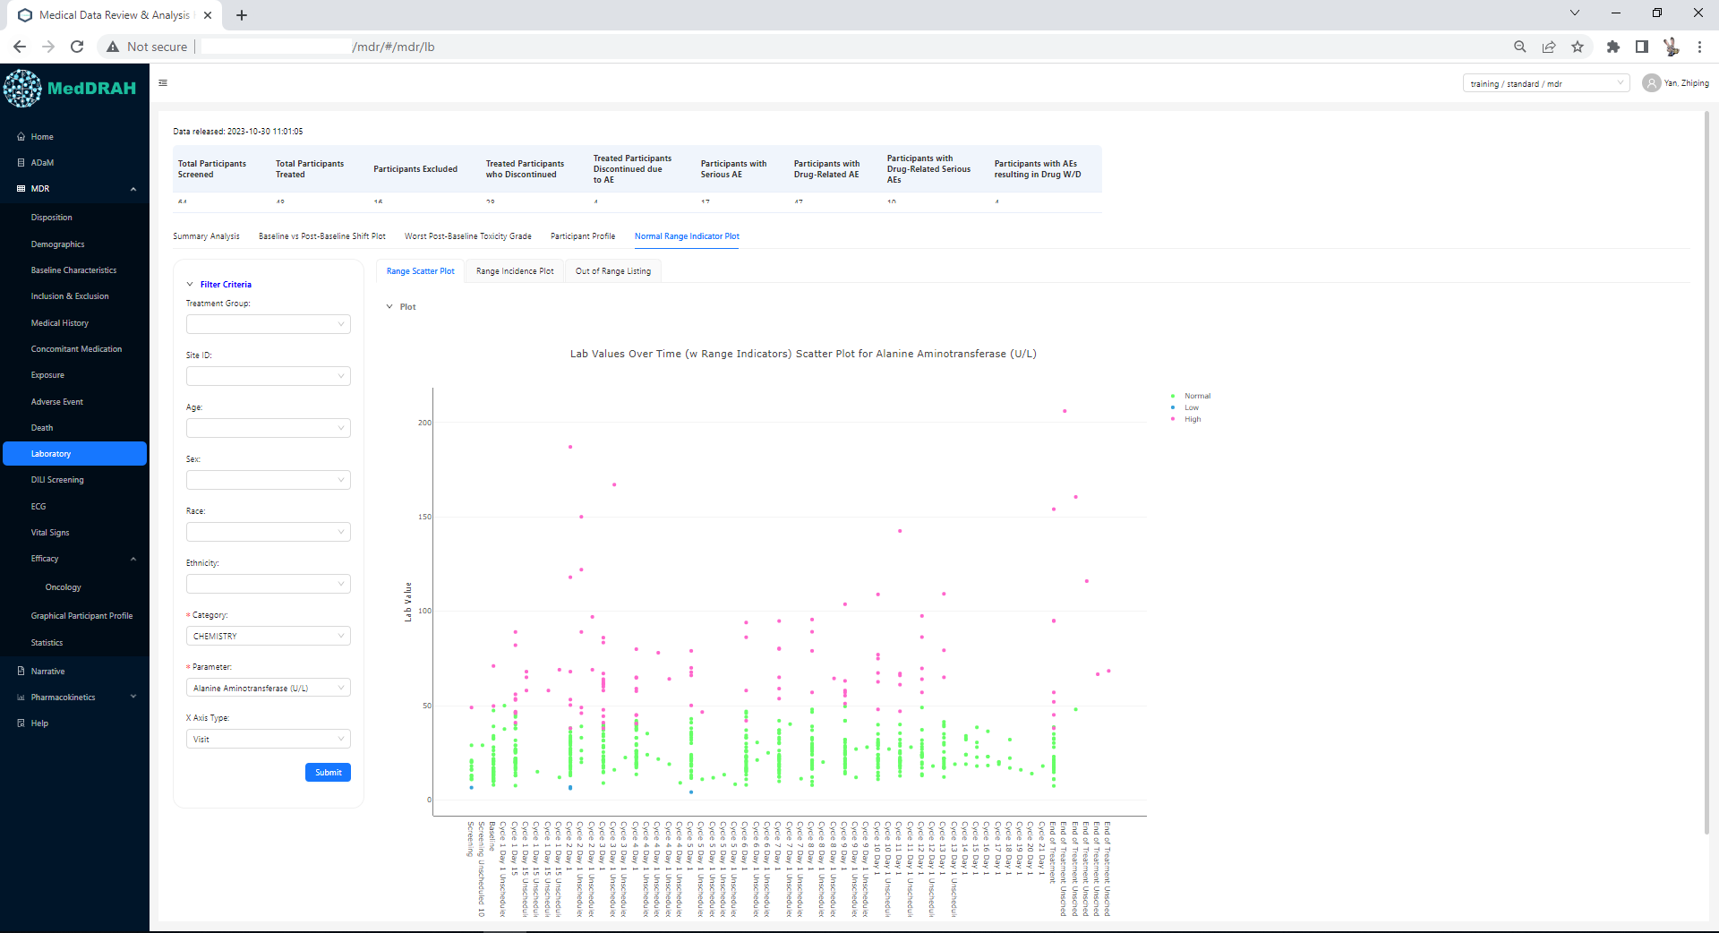
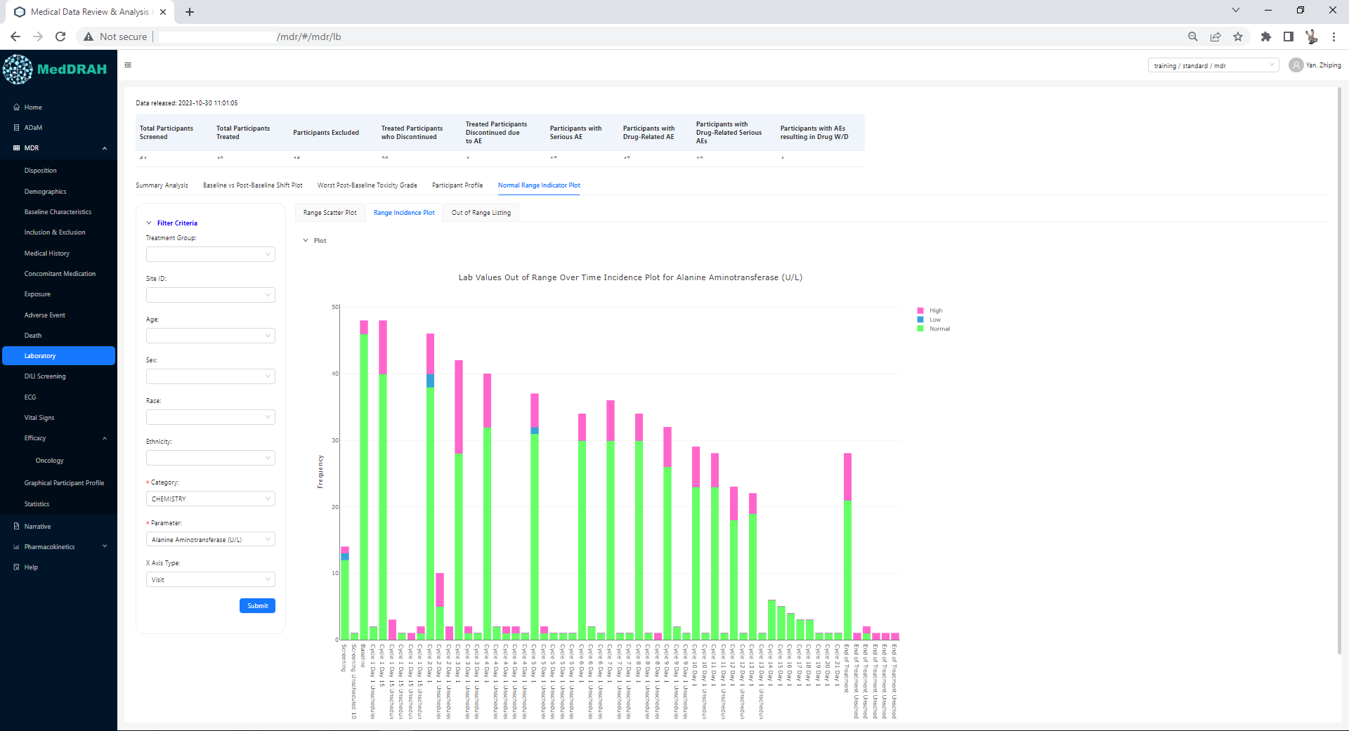
Front End by React – Example
Example plot to view normal range

Slide 25
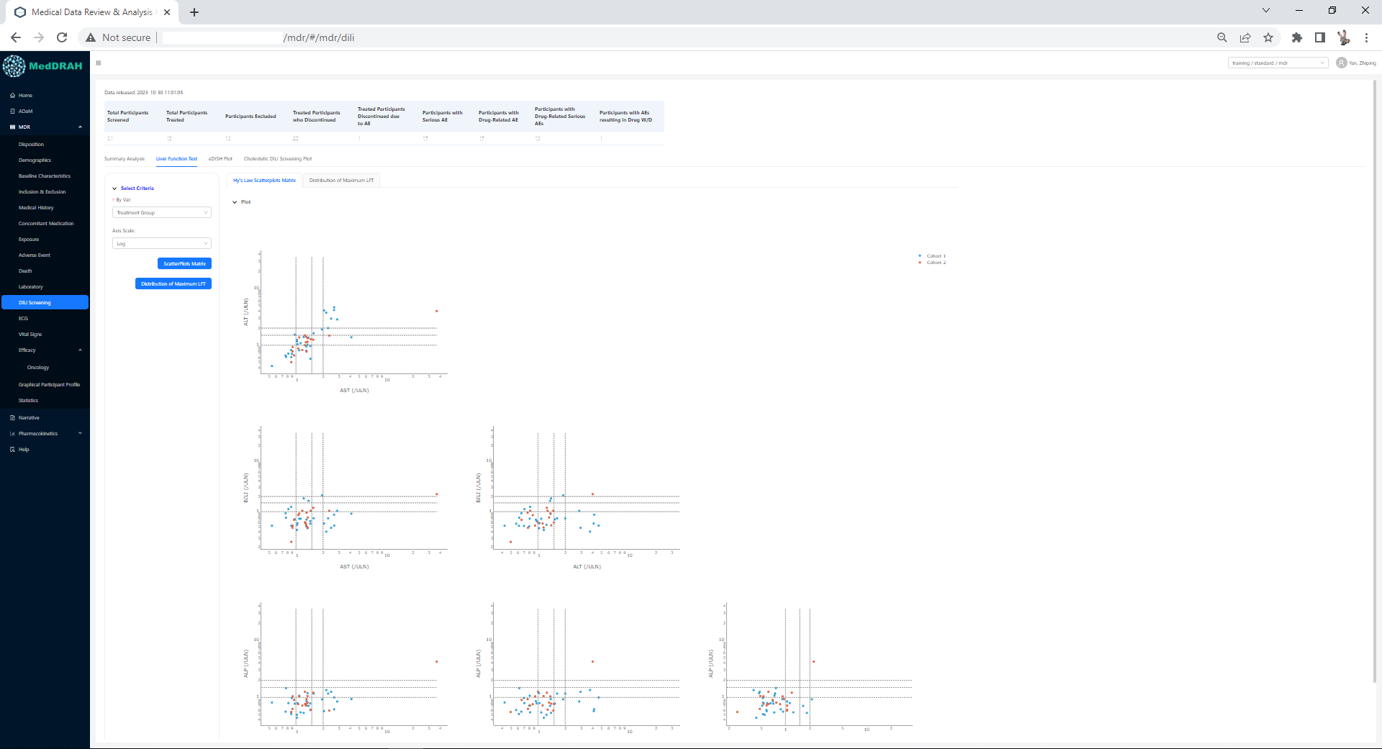
Front End by React – Example
Scatter plot matrix

Slide 26
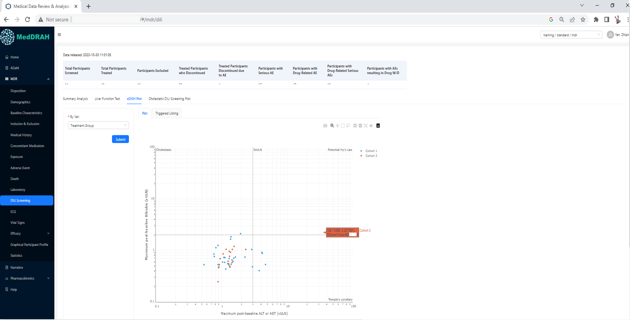
Front End by React – Example
eDISH plot

Slide 27
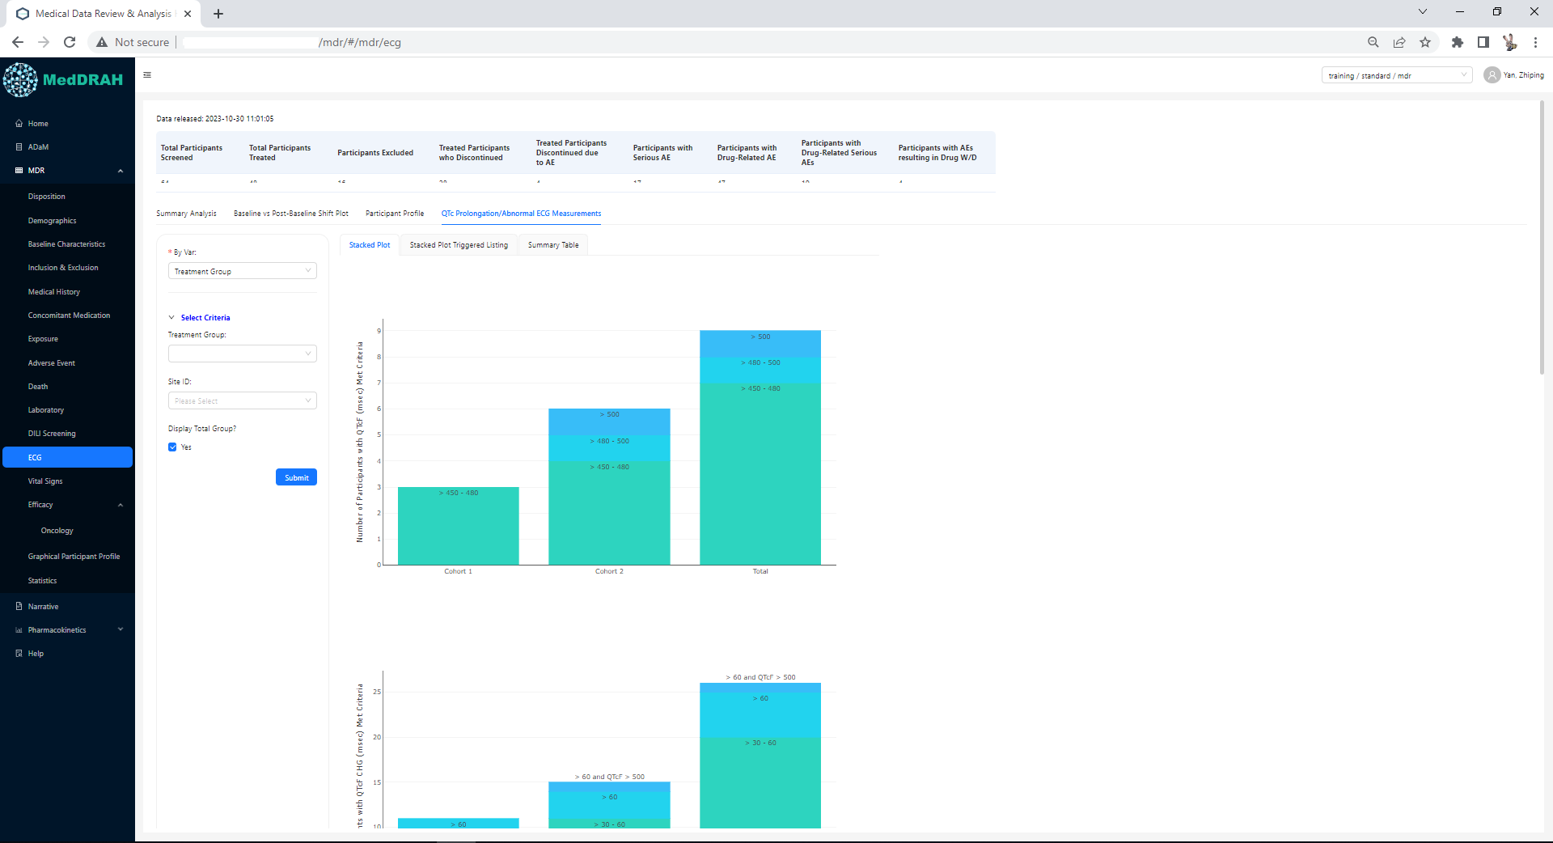
Front End by React – Example
QTc Prolongation/Anormal ECG plot

Slide 28
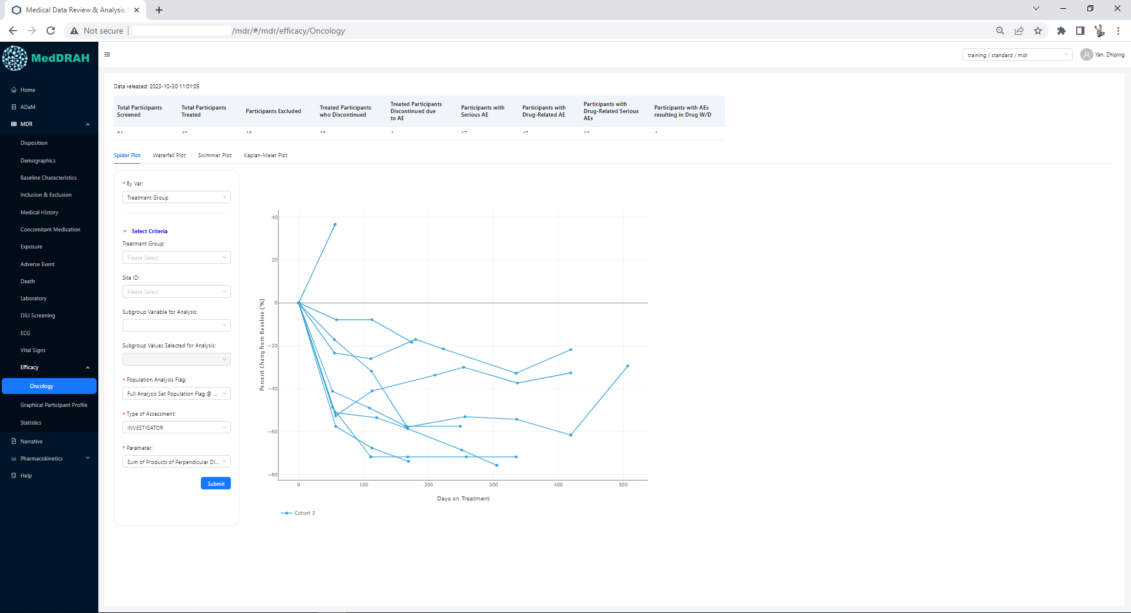
Front End by React – Example
Spider Plot

Slide 29
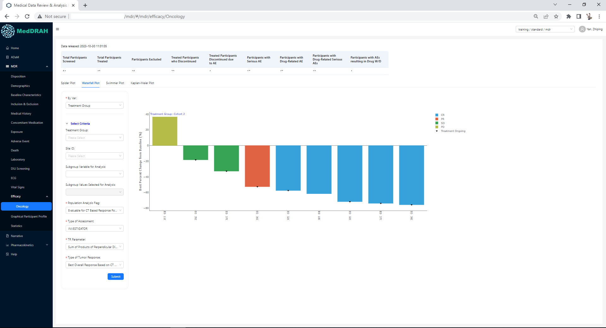
Front End by React – Example
Waterfall Plot

Slide 30
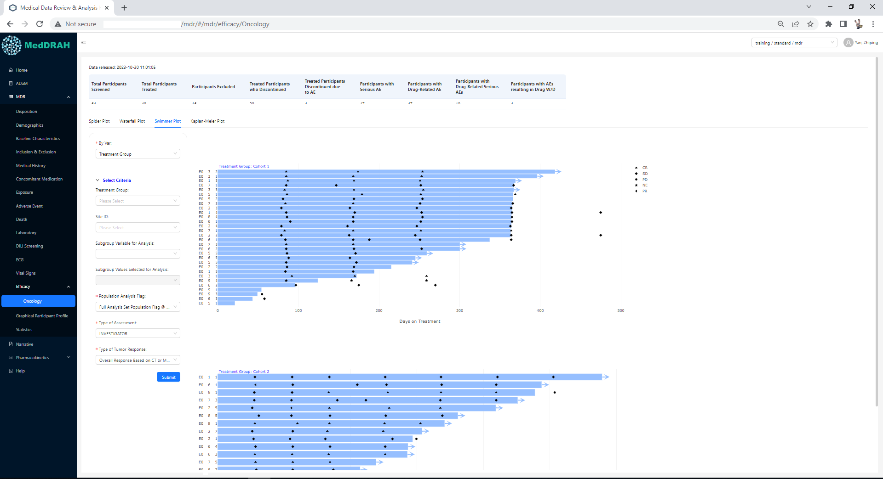
Front End by React – Example
Swimmer Plot

Slide 31
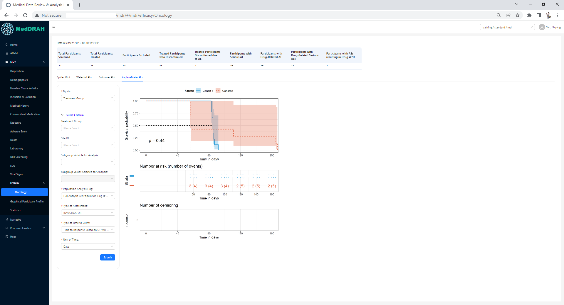
Front End by React – Example
KM Plot

Slide 32
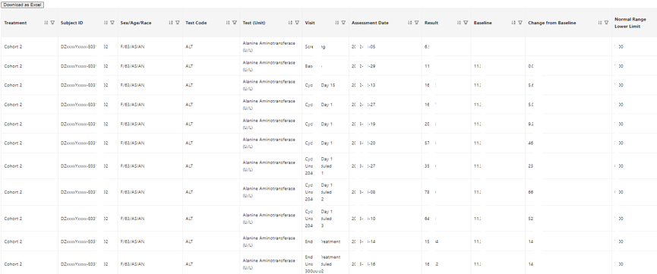
Front End by React - Example
users can interact with plot
e.g. hover information, click event

Slide 33
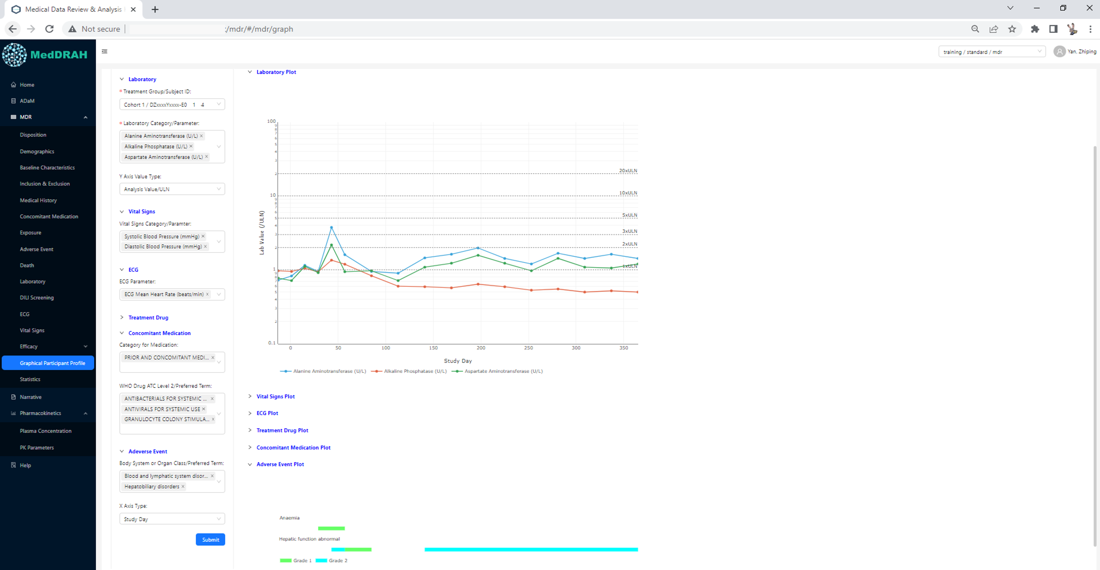
Front End by React - Example
Users can check data across different domains
* due to limited space, vital sign plot, ECG plot, treatment drug plot, concomitant medication plot were hided

Slide 34
Summary
JavaScript as a front-end technology and R or Python as back-end technologies can be used for Web-base platform development. It is the secondary preference for us apart from R-shiny.
The basic R packages can optimize the flexibility, extensibility, and autonomy
The development of the technology platform can be enhanced by implementing a suitable IT architecture.
Clinical data can be shared across different functions with various contents
The Ongoing Aggregate Safety Evaluations (OASEs) including data visualization can be implemented though an innovative platform

Slide 35
Acknowledgement
Many thanks to Huadan Li, Zongming Guo, Wei Zhang, Echo Zhuo and all Statistical Programming team for the great support!

